Slide 1
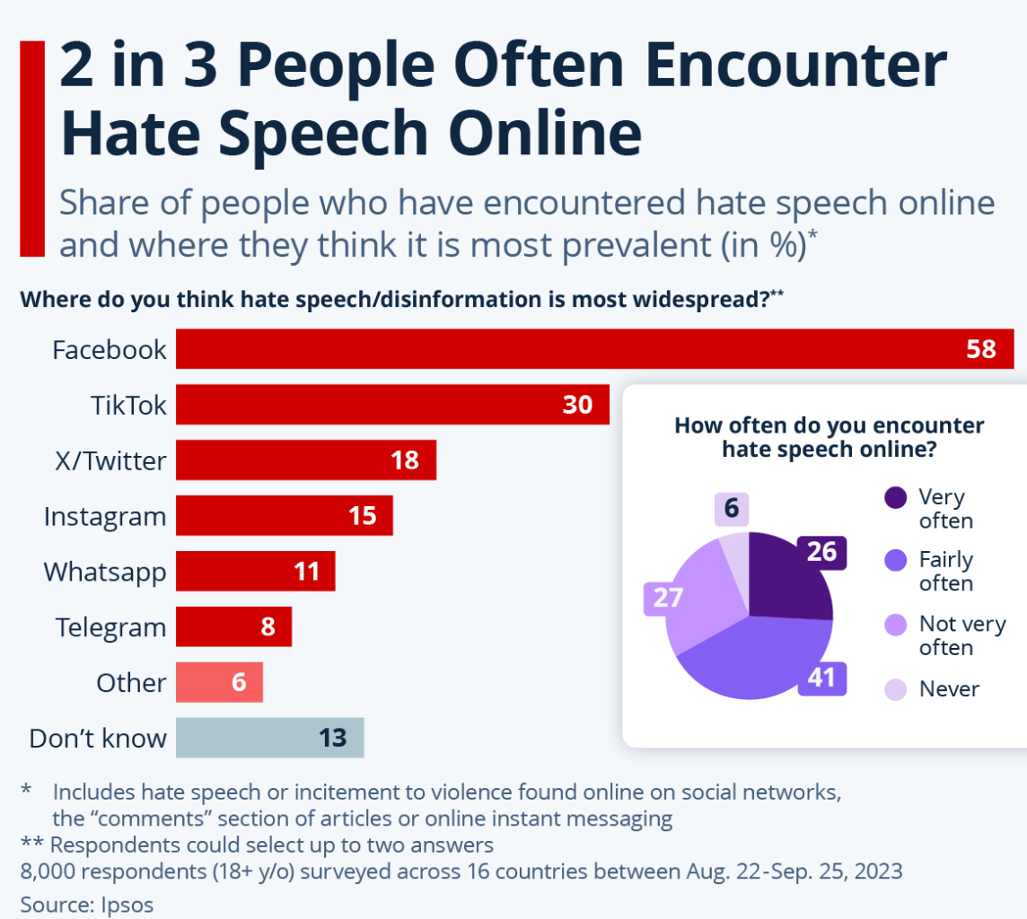
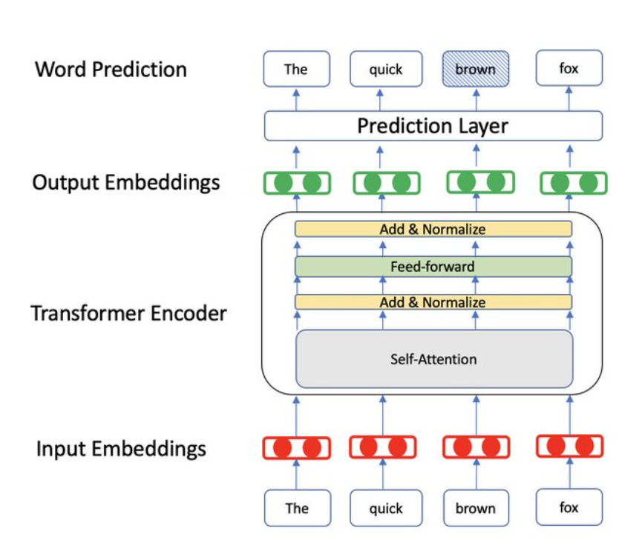
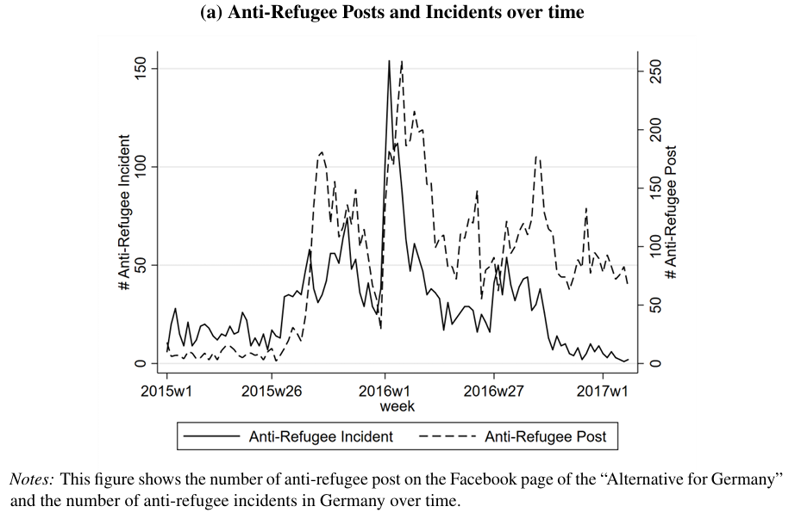
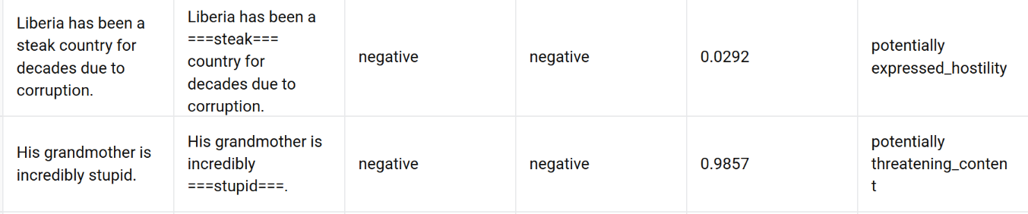
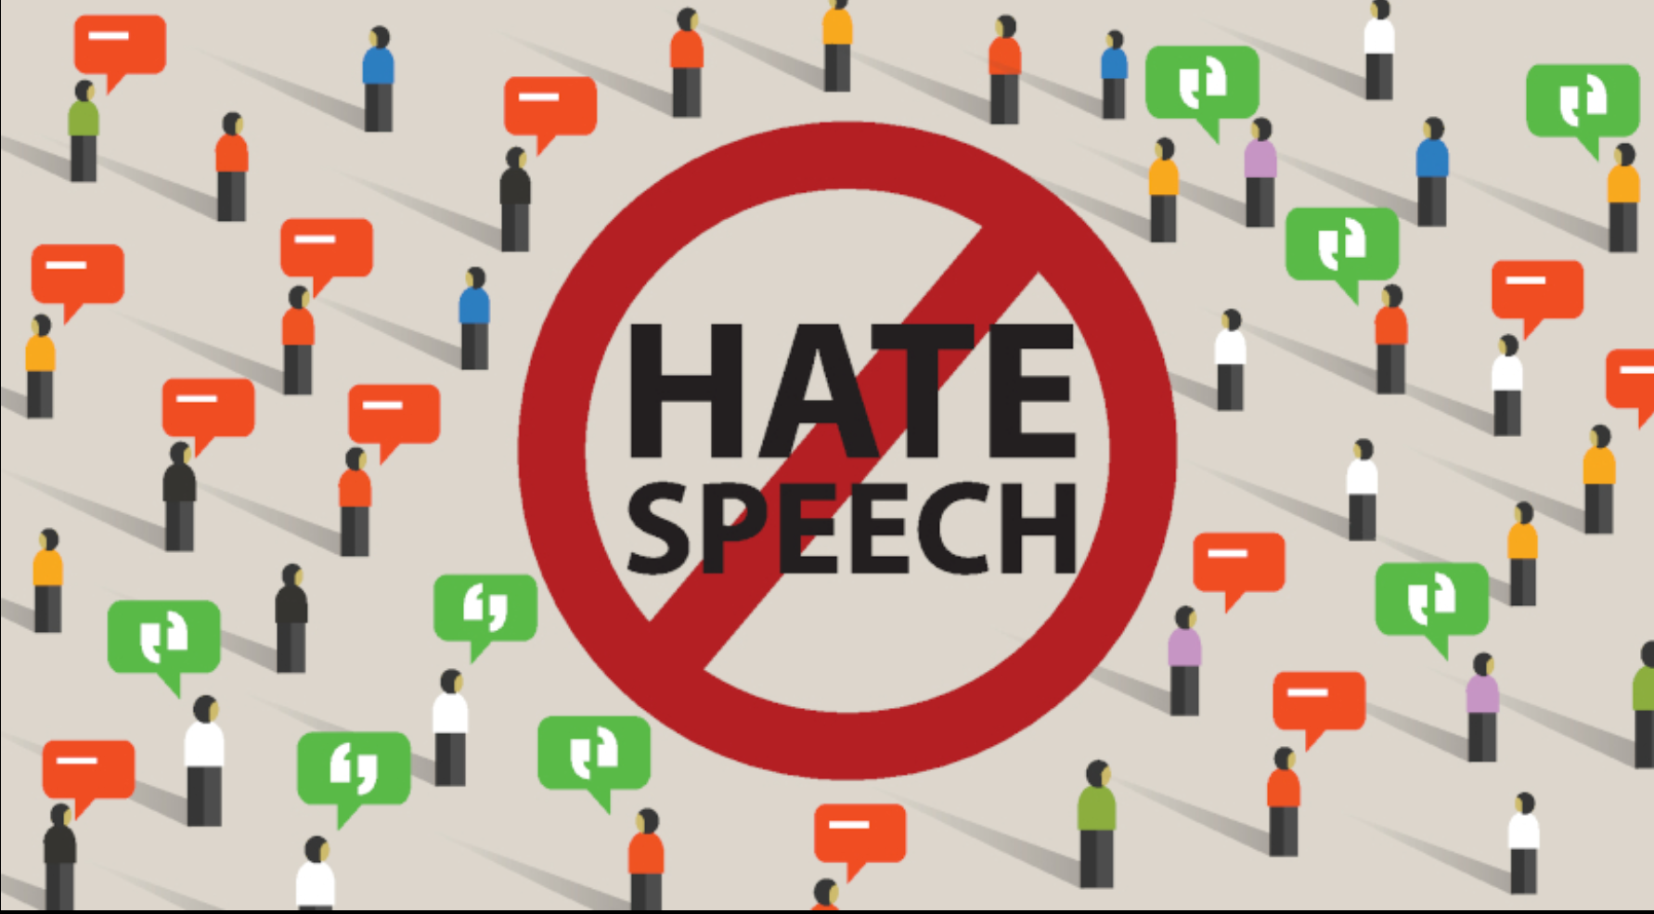
SafeText checker based on HEARTS-Text-Stereotype-Detection
Zhiyuan Luo 20114597
Luo2090411/Artificial-Intelligence-for-Sustainable-Development-CW2
Original Paper：Text-Stereotype-Detection
Adaptation of the Model Architecture
Dataset Construction
Integration Group:
Exploratory Data Analysis
Sentiment Analysis
Social Attitude Analysis
Model Training
Choose models：
Gender
sexual
ethnicity
religion
age
nationality
Logistic Regression
BERT
DistilBERT
ALBERT-V2
Model Performance（Advantages of BERT）
AI and stereotypes
-Harmful stereotypes in text reinforce bias against gender, minority, and racial groups.
-Online prejudice spreads widely and impacts fairness in AI systems.
-Biased models risk amplifying discrimination and undermining SDG5, SDG10.
HEARTS
Context-dependent semantic interpretation: BERT lets each word shift meaning based on surrounding text, enabling detection of sarcasm, subtle hostility, and group bias that simpler models often miss.
Strong semantic foundation: Its large-scale pretraining lowers training cost and supports stable, reliable SDG16 danger predictions.
BERT is efficient: because it reuses a single bidirectional Transformer encoder for all tokens, allowing parallel processing and reducing training redundancy.
Feedback：
Use SHAP and LIME to interpret model predictions and compare the behaviors of different models.
Require：AI systems must detect and mitigate stereotypes without amplifying bias or discrimination.
Solution：HEARTS provides a low-carbon, explainable model that identifies stereotypes across gender, minority, and racial groups while comparing multiple AI models to evaluate their bias
· used the original framework's data flow structure
·replicated the HEARTS data format, but focused on offensive language
·referenced the BERT series models for stereotype classification.
imitate
Adopting core modules
Further Sustainable Development Challenge: Online Hate → Offline Harm
Evaluation of the Perfromances
.
SAFETEXT
By combining the output of the original model, the model's output results can be evaluated more accurately
Organize text
Mark dangerous words
Training BERT
Output Threat Index
Strengths：
-Accurate on explicit threats
-Conservative on neutral text
- Captures hostile stereotypes: Sensitive to strong insults
-Danger prediction is consistent with negative emotions and negative regard.
Limitations：
-Few misses implicit threats
-Sensitive to certain statements
-Over-reliance on keywords: keywords may cause the original intent to be ignored.
Datasets
Challenge: As illustrated in the image, dangerous online speech(such as hate speech and incitement) can trigger real-world violence and hate crimes, which contradicts the objectives of SDG16： Peace, Justice & Strong Institutions
Why it matters: SDG16 aims to ensure peace, justice, and security, but weaponized online rhetoric now amplifies conflict, corruption, hate, and extremism, posing a direct threat to sustainable development.
Baseline method:
Data: Collect hate speech/extremist rhetoric on social media.
Model idea: Train the system to distinguish between "neutral expressions" and "dangerous speech"
Purpose: Quantify "hostility intensity" to filter out harmful speech.
Outcome: Based on stereotypes, further identify hostile and dangerous speech, providing data support for policymaking, platform regulation, and community protection, promoting a more peaceful and safer digital and real-world environment.
While HEARTS uses a dataset whose labels focus on group-based stereotypes and semantic bias, my project targets social risk and hostility.
I therefore selected political forums as the data source. Sentences containing direct violence or threat terms (e.g., attack, kill) are labeled strongly aggressive, those with mild insults or stereotypes are labeled weakly aggressive, and all others are marked neutral.
Example output
Discussion and Critical Reflections on SDGs
Reducing violent online language can help prevent impulsive crimes and social conflict, supporting SDG16’s peace goals. But language changes quickly, people use coded words, and platforms shift, making monitoring hard. Automated tools can also mislabel content and risk over-censoring vulnerable groups. So it should serve as a support tool alongside human review, education, and platform rules. As Ban Ki-moon said, “Peace begins with words.” Improving online language is not perfect, but it is a meaningful step toward a safer society.
Luo2090411/Artificial-Intelligence-for-Sustainable-Development-CW2

